Slide 1





ASP.NET Identity System
Users, Roles, Authorization, Registration, Login, Logout, …
ASP.NET MVC
SoftUni Team
Technical Trainers
Software University
http://softuni.bg

Slide 2

Table of Contents
Authentication and Authorization – Concepts
ASP.NET Identity System – Overview
Authorization and User Roles
Remote Authentication
Configuring External Login in ASP.NET MVC

Slide 3

Authentication and Authorization
What's the Difference?

Slide 4
Authentication vs. Authorization
Authentication
The process of verifying the identity of a user or computer
Questions: Who are you? How you prove it?
Credentials can be password, smart card, external token, etc.
Authorization
The process of determining what a user is permitted to do on a computer or network
Questions: What are you allowed to do? Can you see this page?

Slide 5
ASP.NET Identity System
Overview

Slide 6
ASP.NET Identity
The ASP.NET Identity system
Authentication and authorization system for ASP.NET Web apps
Supports ASP.NET MVC, Web API, Web Forms, SignalR, Web Pages
Handles users, user profiles, login / logout, roles, etc.
Keeps the user accounts in local database or in external data store
External login (through OAuth)
Supports Facebook, Google, Microsoft, Twitter accounts
Based on the OWIN middleware (can run outside of IIS)
Available through the NuGet package manager

Slide 7
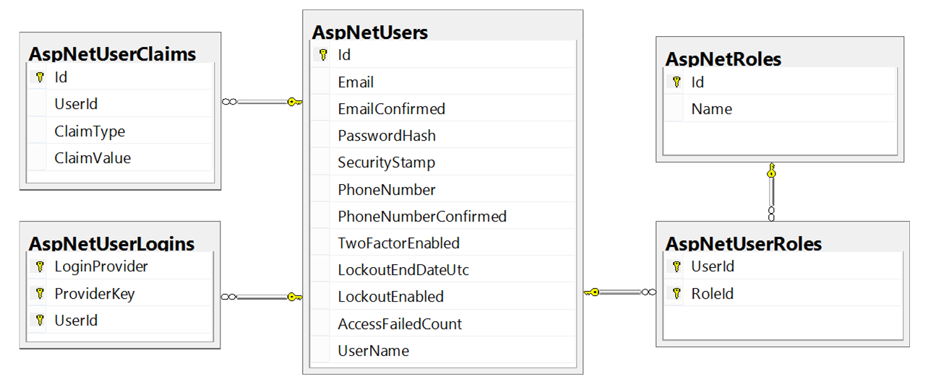
ASP.NET Identity and Entity Framework
Typically, the ASP.NET identity data (users, passwords, roles) is stored in relational database through EF Code First
You have some control over the internal database schema

Slide 8


ASP.NET Identity API
Setup, Registration, Login, Logout

Slide 9
ASP.NET Identity System Setup
Ways to setup ASP.NET Identity based authentication in MVC
Using the ASP.NET project templates from Visual Studio
By hand: install NuGet packages, manual configuration, create EF mappings (models), view models, controllers, views, etc.
Required NuGet packages
Microsoft.AspNet.Identity.Core
Microsoft.AspNet.Identity.Owin
Microsoft.AspNet.Identity.EntityFramework

Slide 10
ASP.NET Project Template Authentication
IdentityConfig.cs – holds the user manager configuration
ApplicationUserManager : UserManager<ApplicationUser>
The main class for managing users in the ASP.NET Identity system
Can define the user and password validation rules
ApplicationSignInManager : SignInManager
Implements the user login / logout
Supports external login, e.g. Facebook login
Two-factor authentication (email confirm)

Slide 11
ASP.NET Project Template Authentication (2)
IndentityModels.cs – holds user class and EF DB context
ApplicationUser : IdentityUser
Holds the user information for the ASP.NET application
Id (unique user ID, string holding a GUID)
E.g. 313c241a-29ed-4398-b185-9a143bbd03ef
Username (unique username), e.g. maria
Email (email address – can be unique), e.g. mm@gmail.com
May hold additional fields, e.g. first name, last name, date of birth

Slide 12
ASP.NET Project Template Authentication (3)
ApplicationDbContext : IdentityDbContext<ApplicationUser>
Holds the EF data context with all database mapped entities
May define database initializer to specify DB migration strategy
Startup.Auth.cs
Configures OWIN to use identity authentication
Usually enables cookie-based authentication
May enable external login (e.g. Facebook login)

Slide 13
User Registration
var newUser = new ApplicationUser
{
UserName = "maria",
Email = "mm@gmail.com",
PhoneNumber = "+359 2 981 981"
};
var userManager = HttpContext.GetOwinContext().
GetUserManager<ApplicationUserManager>();
var result = userManager.Create(newUser, "S0m3@Pa$$");
if (result.Succeeded)
// User registered
else
// result.Errors holds the error messages

Slide 14
User Login
var signInManager = HttpContext.GetOwinContext().
Get<ApplicationSignInManager>();
bool rememberMe = true;
bool shouldLockout = false;
var signInStatus = signInManager.PasswordSignIn(
"maria", "S0m3@Pa$$", rememberMe, shouldLockout);
if (signInStatus == SignInStatus.Success)
// Sucessfull login
else
// Login failed

Slide 15
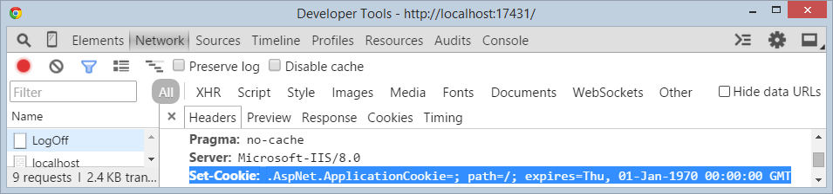
User Logout
Performs local / external logout logout (log off / sign out):
Logging out clears the authentication cookies
var authenticationManager =
HttpContext.GetOwinContext().Authentication;
authenticationManager.SignOut();
// Redirect to home screen or login screen

Slide 16
Change Password
Logged-in user changes his password:
Administrator resets some user's password:
var currentUser = User.Identity.GetUserId();
var userManager = HttpContext.GetOwinContext().
GetUserManager<ApplicationUserManager>();
var result = userManager.ChangePassword(
currentUser, "old pass", "new pass");
if (result.Succeeded) { … }
string token = userManager.GeneratePasswordResetToken (userId);
var result = userManager.ResetPassword(
userId, token, "new password");

Slide 17
Extending the User Profile
To extend the user profile
Just add properties to ApplicationUser class
Enable migrations for the project / data layer
E.g. in Global.asax set the database initializer
public class ApplicationUser : IdentityUser
{
[Required]
public string Name { get; set; }
…
}

Slide 18



Authorization and User Roles

Slide 19
ASP.NET Authorization
Use the [Authorize] and [AllowAnnonymous] attributes to configure authorized / anonymous access for controller / action
[Authorize]
public class AccountController : Controller
{
// GET: /Account/Login (annonymous)
[AllowAnonymous]
public ActionResult Login(string returnUrl) { … }
// POST: /Account/LogOff (for logged-in users only)
[HttpPost]
public ActionResult LogOff() { … }
}

Slide 20
Check the Currently Logged-In User
// GET: /Account/Roles (for logged-in users only)
[Authorize]
public ActionResult Roles()
{
var currentUserId = this.User.Identity.GetUserId();
var userManager = HttpContext.GetOwinContext().
GetUserManager<ApplicationUserManager>();
var user = userManager.FindById(currentUserId);
ViewBag.Roles = user.Roles;
return this.View();
}

Slide 21
Create a New Role
Identity roles group users to simplify managing permissions
ASP.NET MVC controllers and actions could check the user role
Creating a new role:
var roleManager = new RoleManager<IdentityRole>(
new RoleStore<IdentityRole>(new ApplicationDbContext()));
var roleCreateResult =
roleManager.Create(new IdentityRole("Administrator"));
if (! roleCreateResult.Succeeded)
{
throw new Exception(string.Join("; ", roleCreateResult.Errors));
}

Slide 22
Add User to a Role
Adding a user to existing role:
var userManager = HttpContext.GetOwinContext().
GetUserManager<ApplicationUserManager>();
var addAdminRoleResult =
userManager.AddToRole(adminUserId, "Administrator");
if (addAdminRoleResult.Succeeded)
{
// The user is now Administrator
}

Slide 23
Require Logged-In User in Certain Role
Give access only to users in role "Administrator":
Give access if user's role is "User", "Student" or "Trainer":
[Authorize(Roles="Administrator")]
public class AdminController : Controller
{ … }
[Authorize(Roles="User, Student, Trainer")]
public ActionResult Roles()
{
…
}

Slide 24
Check the Currently Logged-In User's Role
// GET: /Home/Admin (for logged-in admins only)
[Authorize]
public ActionResult Admin()
{
if (this.User.IsInRole("Administrator"))
{
ViewBag.Message = "Welcome to the admin area!";
return View();
}
return this.View("Unauthorized");
}

Slide 25

Remote Authentication
Claims-Based Authentication in ASP.NET

Slide 26
Claims-Based Authentication (1)
Claims
Piece of information identifying user
Sent as key-value pairs
Contains authentication token and/or signature
Claims-based authentication
Users authenticate on remote system
Information is passed to the application
User is authenticated and recognized

Slide 27
Claims-Based Authentication (2)
Authentication flow
User makes request to application
System redirects to external page
After authentication the external system returns back to the application with user information
Application makes request to external system to validate user
User gets access to the application

Slide 28
OAuth2
OAuth
Allows secure authentication
Simple and standard protocol
Can be used by web, desktop or mobile apps
Steps
Users tries to authenticate at application
Application relies on remote service
Application receives access token
User gets access

Slide 29
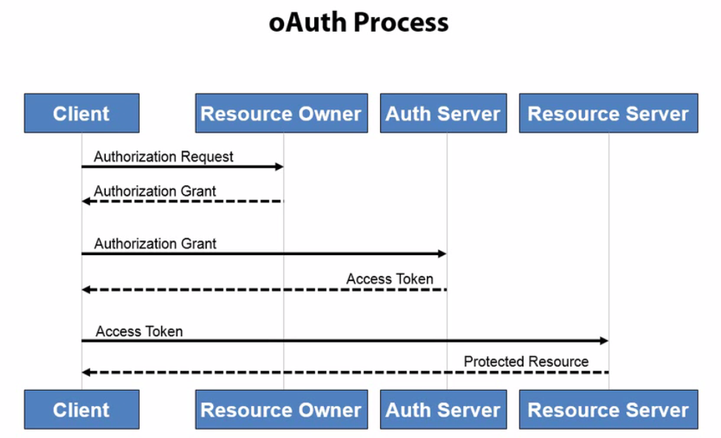
OAuth2 Process

Slide 30
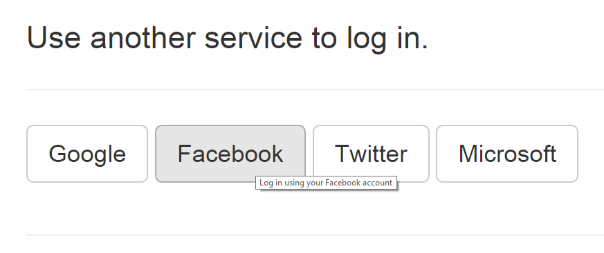
Configuring External Login
OAuth and OWIN Authorization

Slide 31
Enable External Login in ASP.NET MVC
public partial class Startup
{
public void ConfigureAuth(IAppBuilder app)
{
…
app.UseFacebookAuthentication(
appId: "xxx", appSecret: "yyy");
app.UseGoogleAuthentication(
new GoogleOAuth2AuthenticationOptions()
{ ClientId = "xxx", ClientSecret = "yyy" }
);
}
}

Slide 32

Summary
Authentication vs. Authorization
ASP.NET Identity
Custom users
Registration, login, logout
Change password
User roles and role management
External logins

Slide 33








ASP.NET Identity
https://softuni.bg/courses/

Slide 34
License
This course (slides, examples, demos, videos, homework, etc.) is licensed under the "Creative Commons Attribution-NonCommercial-ShareAlike 4.0 International" license
Attribution: this work may contain portions from
"ASP.NET MVC" course by Telerik Academy under CC-BY-NC-SA license

Slide 35





Free Trainings @ Software University
Software University Foundation – softuni.org
Software University – High-Quality Education, Profession and Job for Software Developers
softuni.bg
Software University @ Facebook
facebook.com/SoftwareUniversity
Software University @ YouTube
youtube.com/SoftwareUniversity
Software University Forums – forum.softuni.bg

